Slide 1
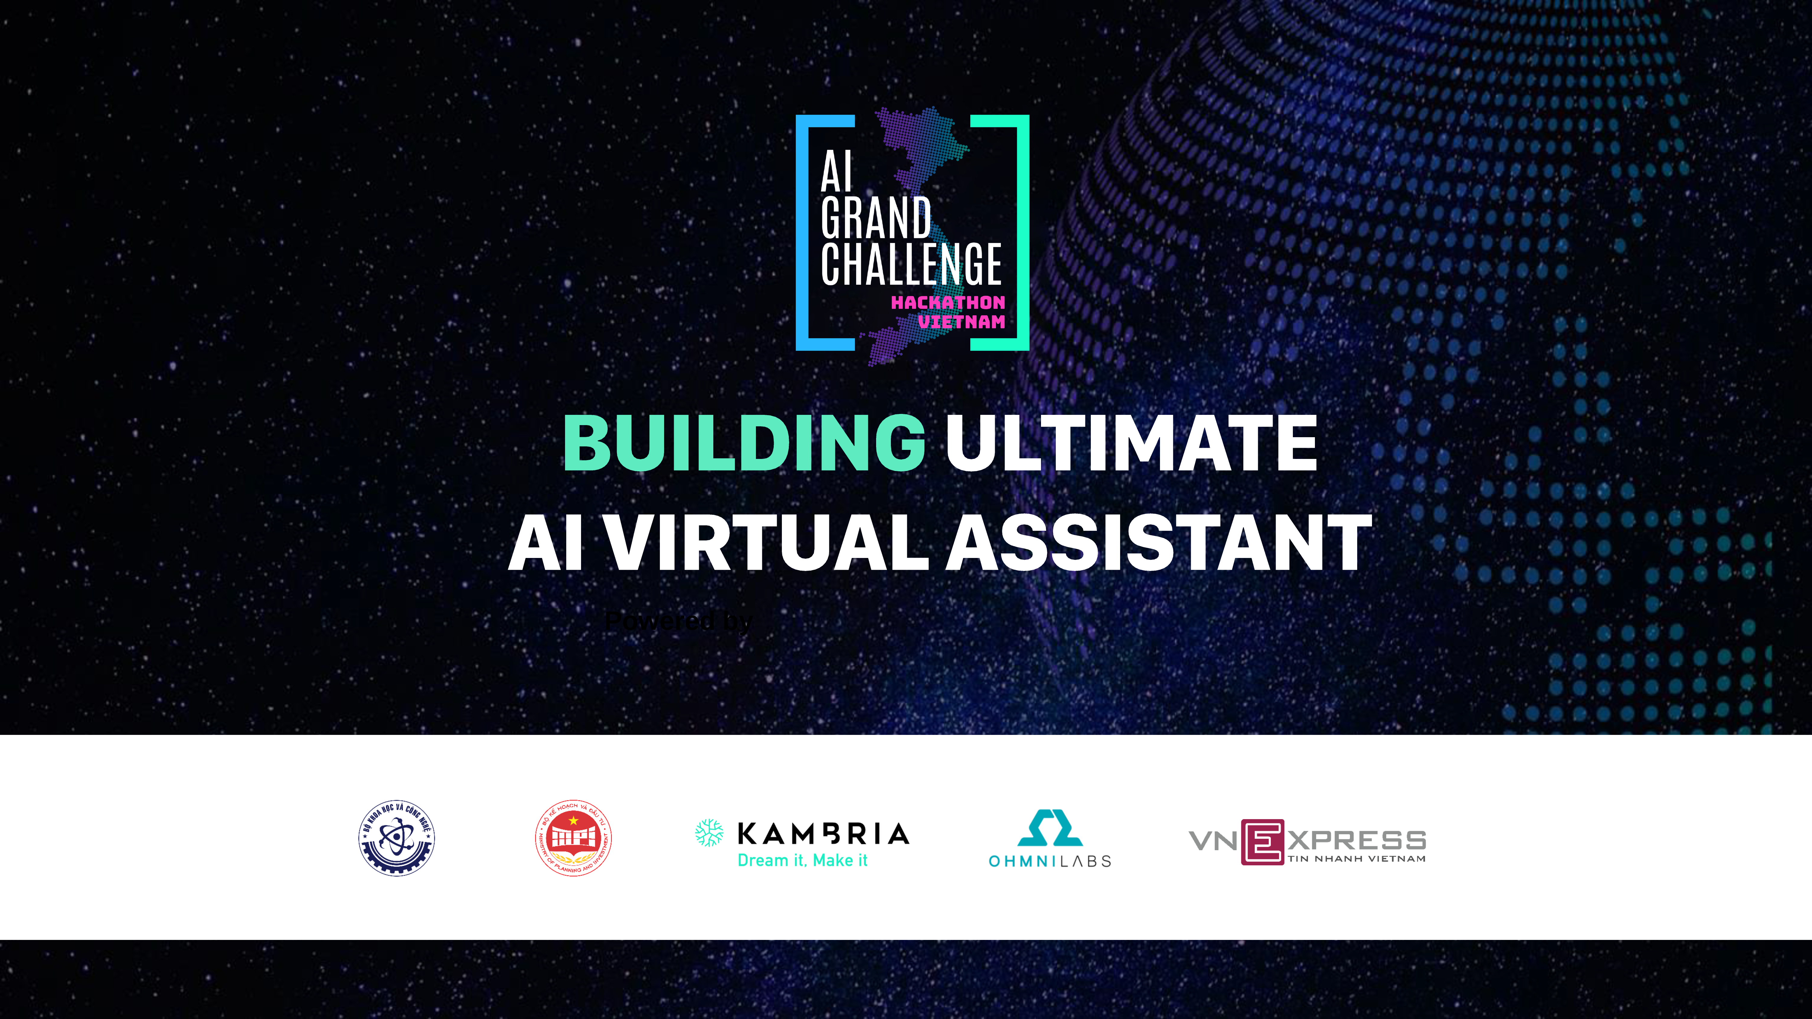

Slide 2
WhiteBunny
SMTHV

Slide 3
Who are we?
Lưu Trường Sinh -> dev
Nguyễn Quang Minh -> dev
Nguyễn Ngọc Trung -> dev

Slide 4

Problem Statement
Feeling bored when studying alone -> less effective

Slide 5
Solution
A chatbot that helps students to learn more effective and engaging

Slide 6
Three features
Students can practice questions, exercises
Personalize learning process
Study reminders

Slide 7
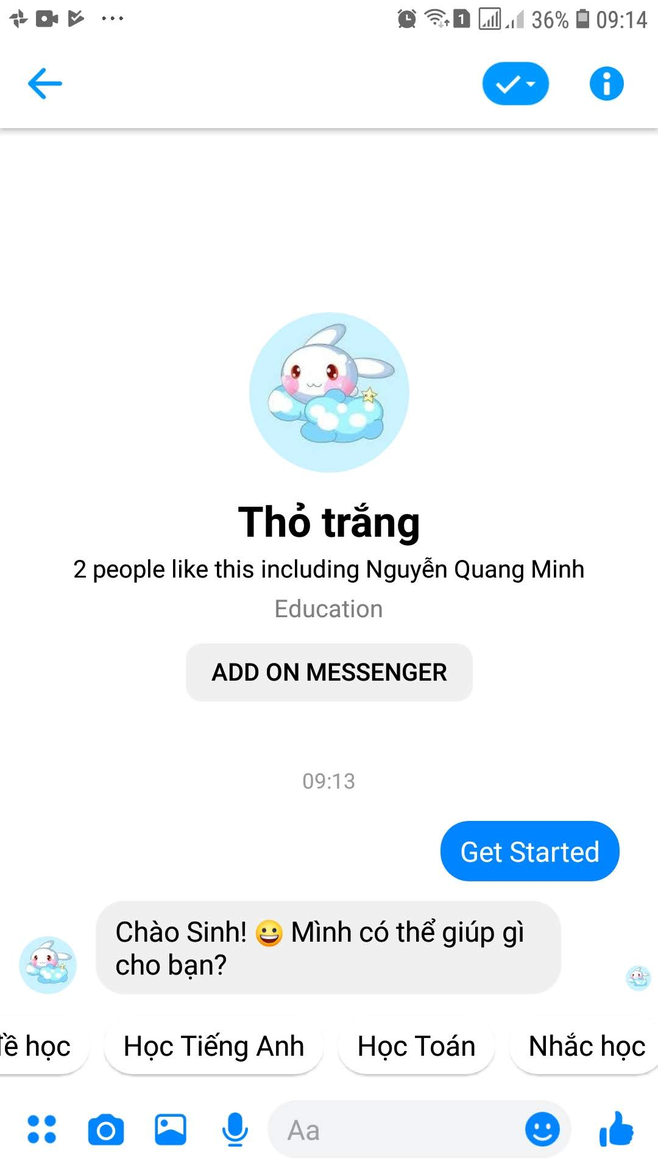
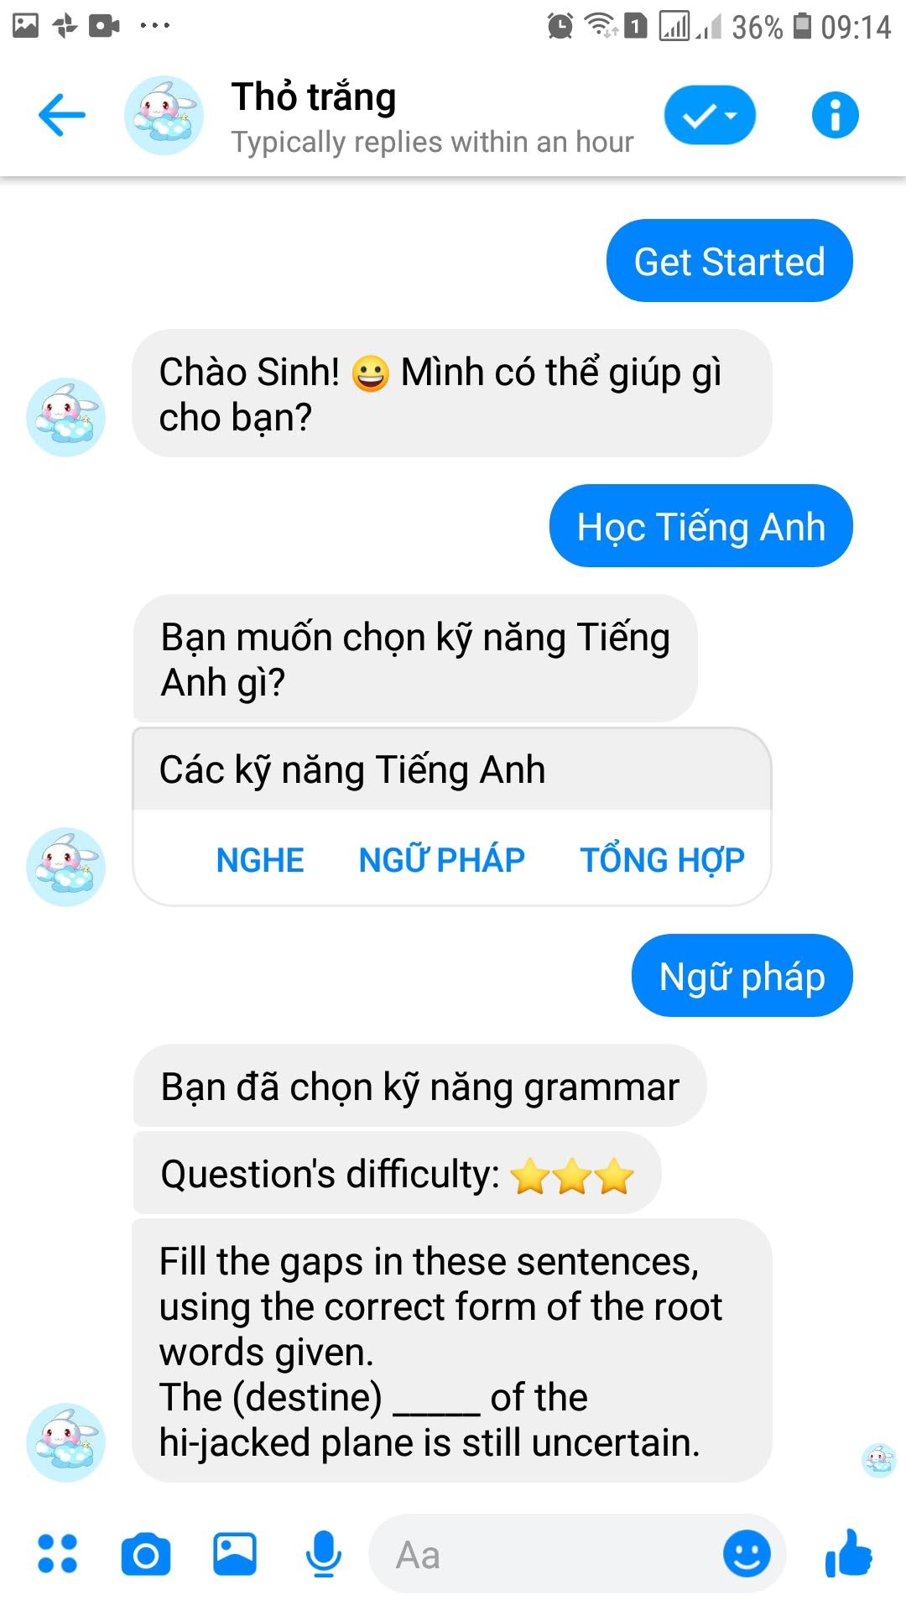
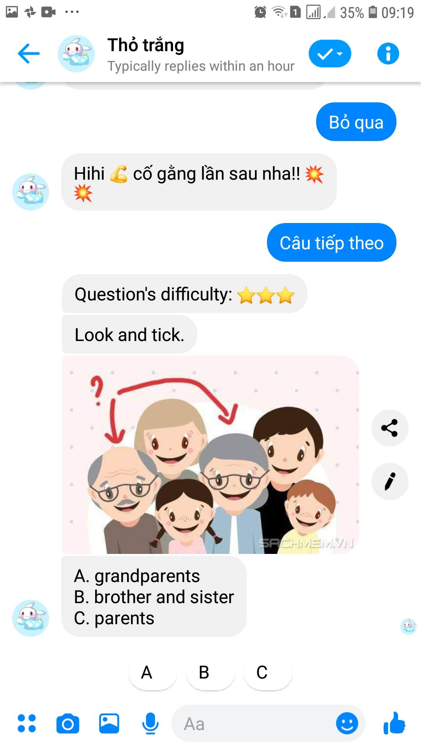
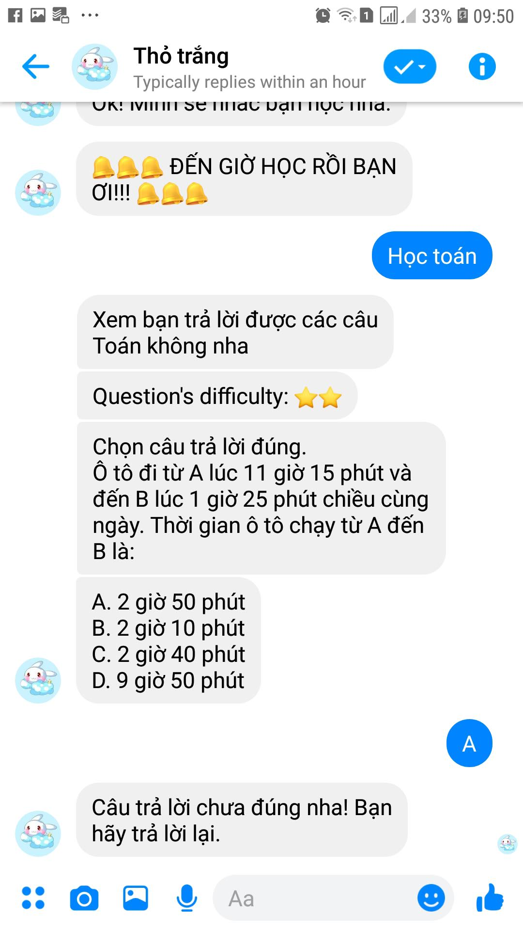
Practice questions, exercises

Slide 8
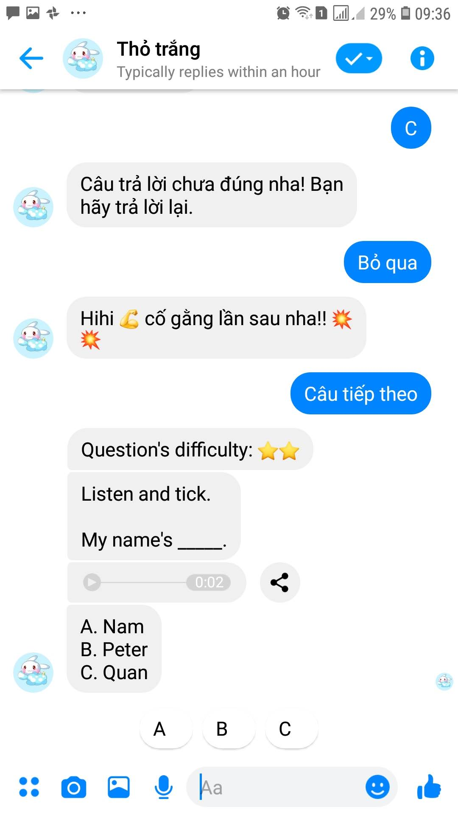
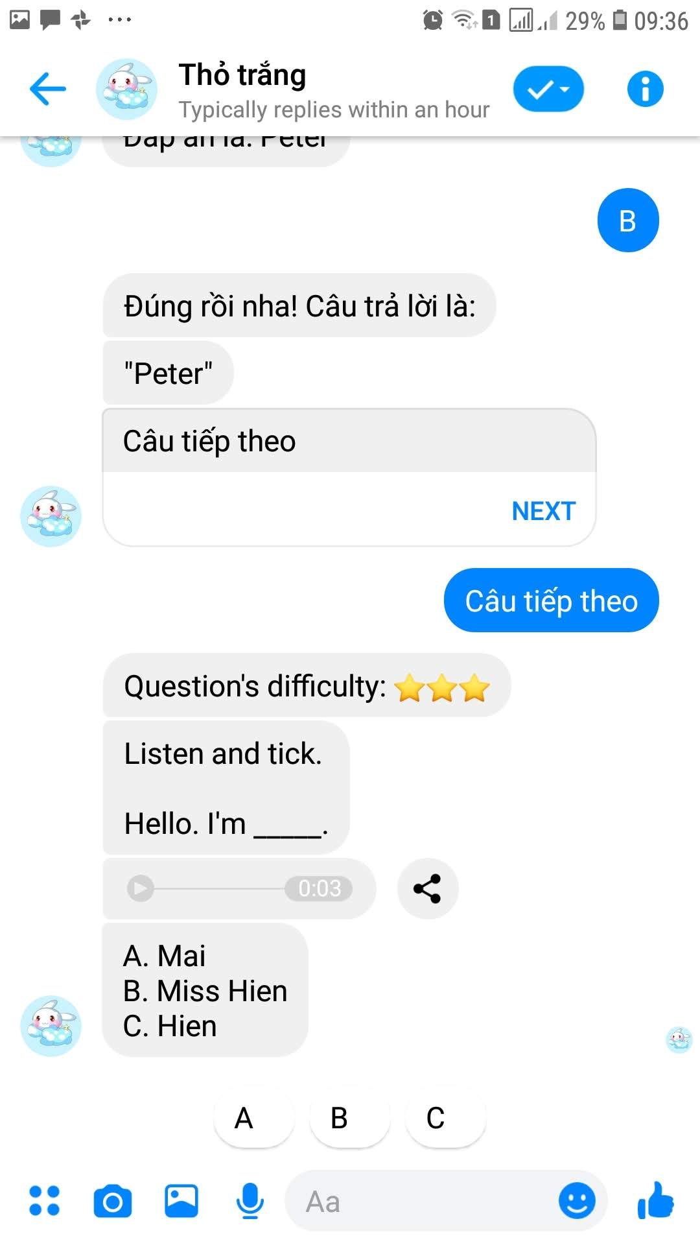
Personalize learning process
Choose more difficult questions when the history questions are easy for the student

Slide 9
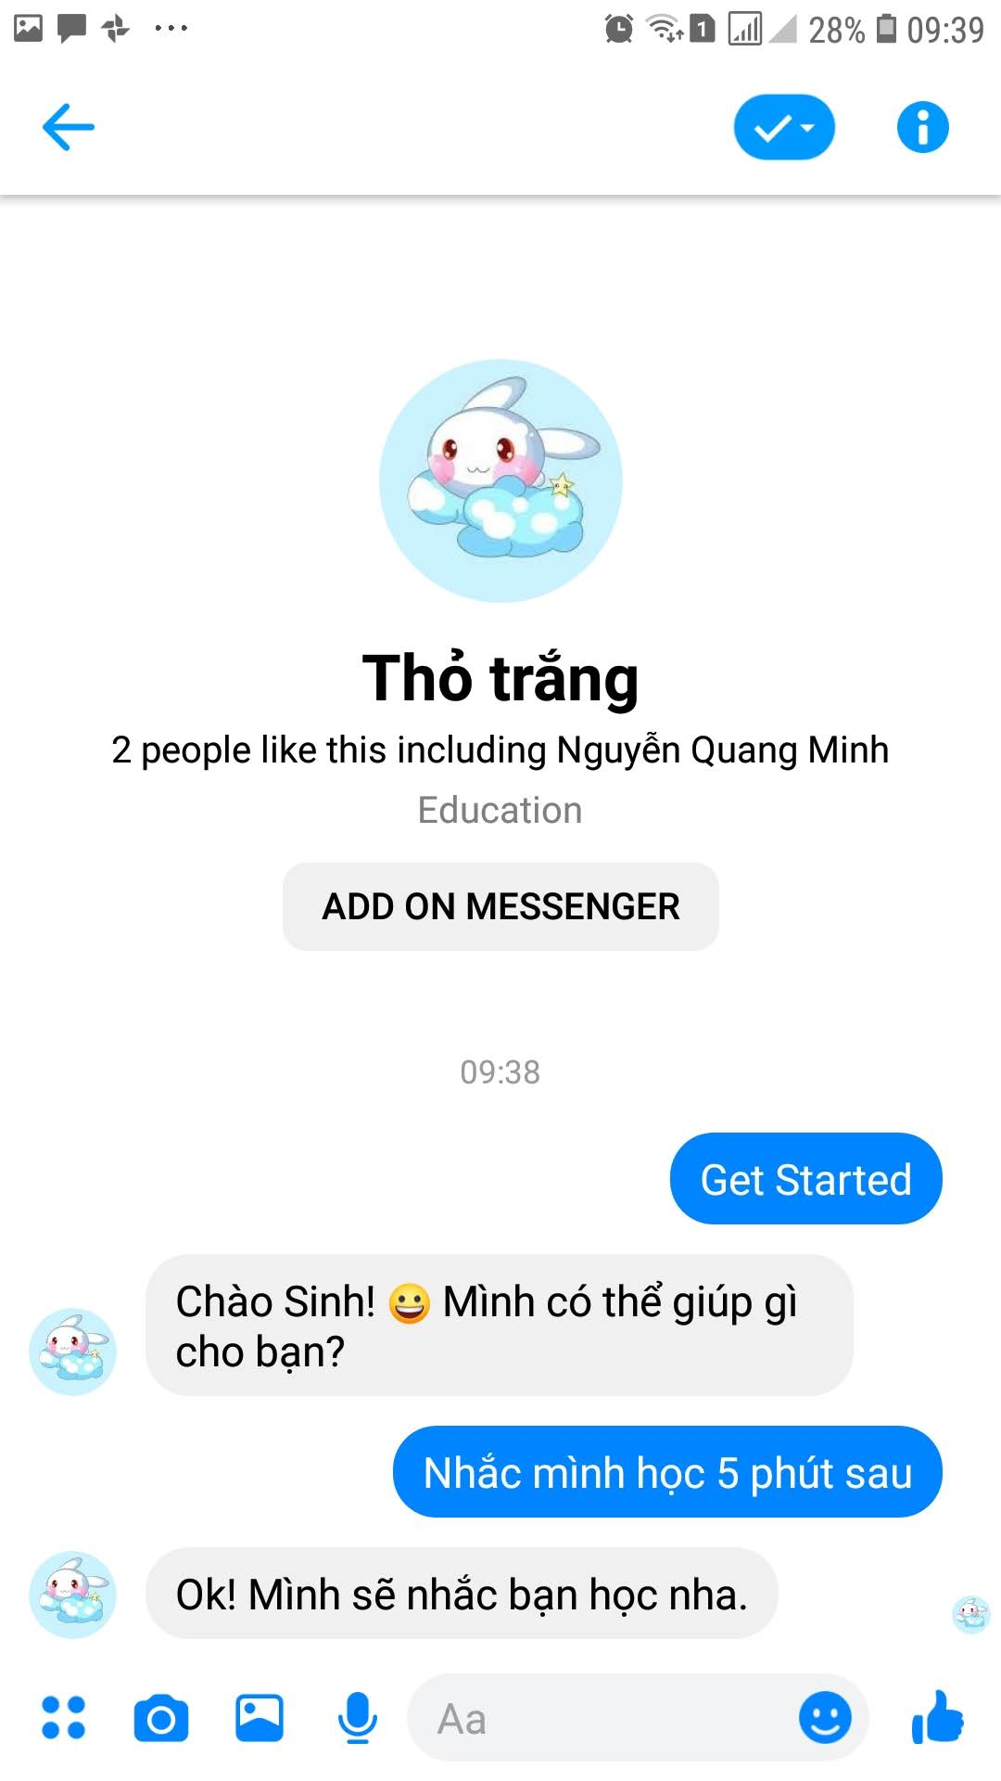
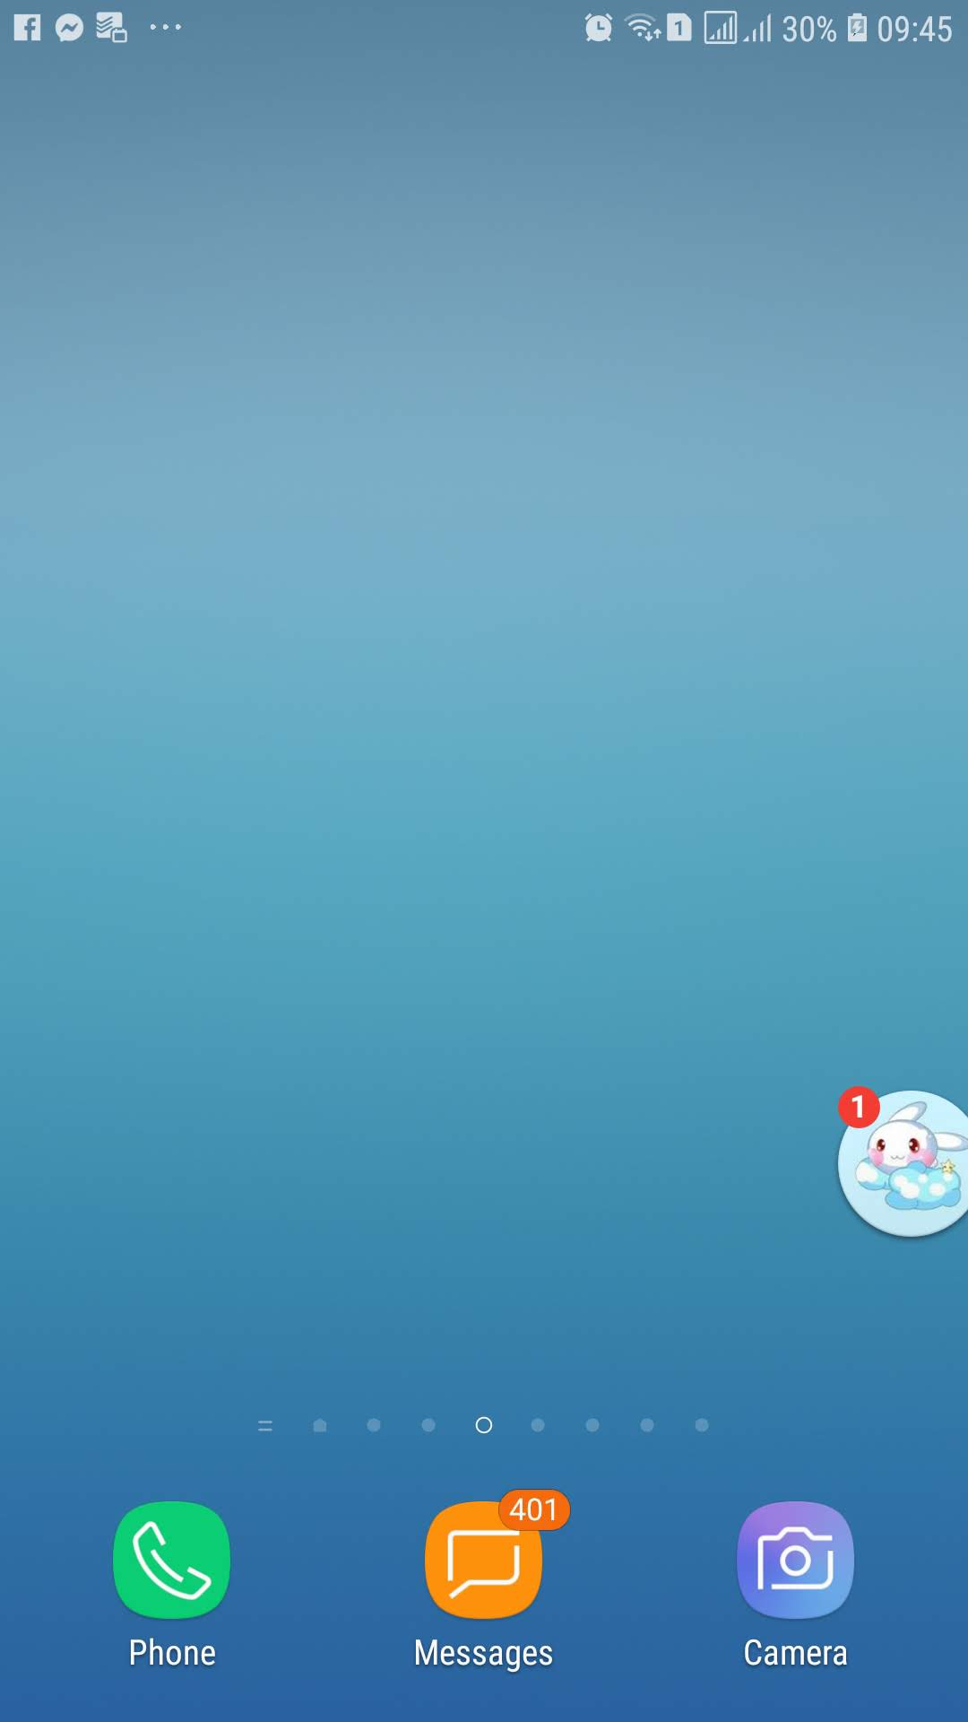
Study reminders
Remind after 5 minutes

Slide 10

Technology
Custom chatbot framework based on Rasa
Example courseware data service

Slide 11


Business Model
Sell chatbot service for educational organizations
Our team
create
serve
pay
Educational organizations
provide data

Slide 12
Execution Plan
Marketing strategy: create free chatbots for users to use

Slide 13
Thank you!

Slide 14
Participants
Sinh luu
sinhlt58@gmail.com
Trung nguyen
ngoctrunght19@gmail.com
Minh nguyen
nqminh164@gmail.com

Slide 15
Resource Slides

